Slide 1
Computer Networks Part-1
by Aarushi Bansal
from Devnation Community

Slide 2
Network
When multiple devices are interconnected using multiple paths for the purpose of sending/receiving data or media

Slide 3
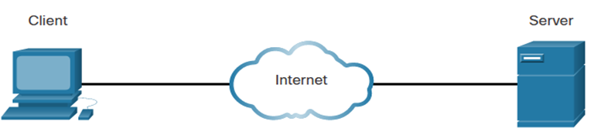
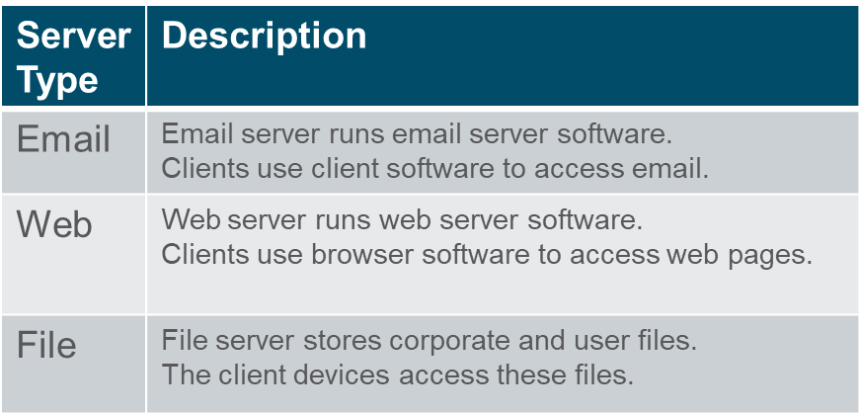
Network Components Host Roles
Every computer on a network is called a host or end device.
Servers are computers that provide information to end devices:
email servers
web servers
file server
Clients are computers that send requests to the servers to retrieve information:
web page from a web server
email from an email server

Slide 4
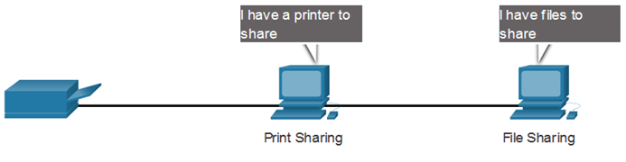
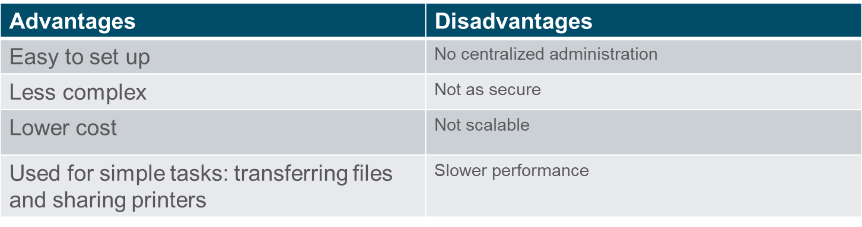
Network Components Peer-to-Peer
It is possible to have a device be a client and a server in a Peer-to-Peer Network. This type of network design is only recommended for very small networks.

Slide 5
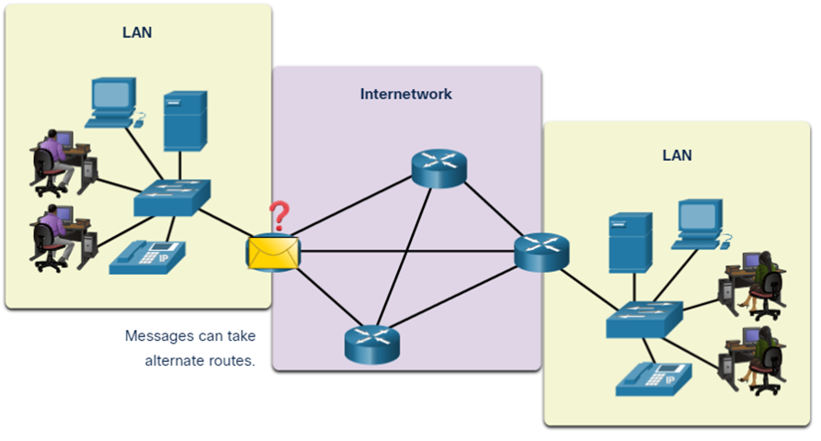
Network Components End Devices
An end device is where a message originates from or where it is received. Data originates with an end device, flows through the network, and arrives at an end device.

Slide 6
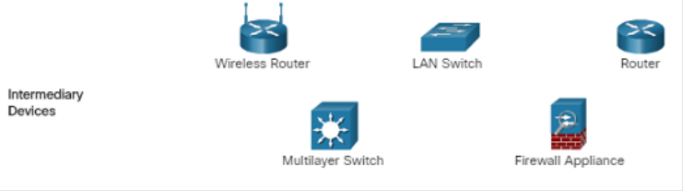
Network Components Intermediary Network Devices
An intermediary device interconnects end devices. Examples include switches, wireless access points, routers, and firewalls.
Management of data as it flows through a network is also the role of an intermediary device, including:
Regenerate and retransmit data signals.
Maintain information about what pathways exist in the network.
Notify other devices of errors and communication failures.

Slide 7
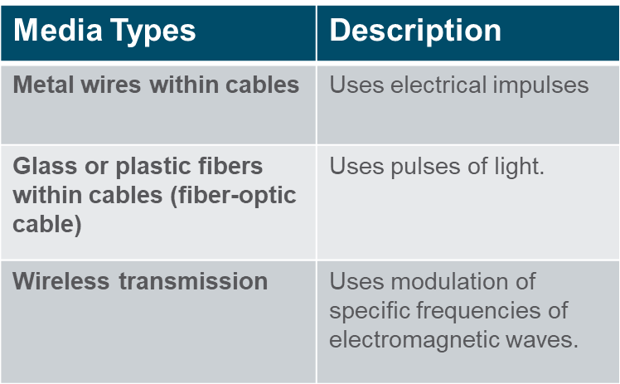
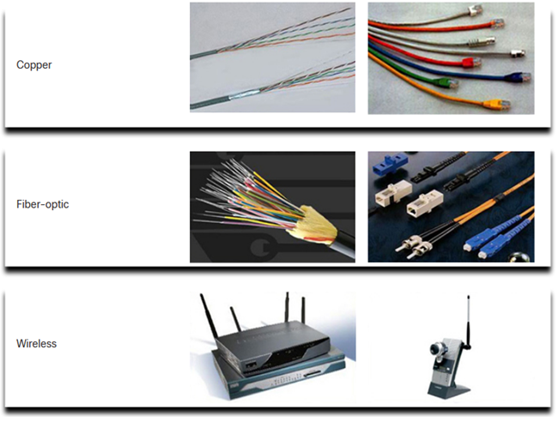
Network Components Network Media
Communication across a network is carried through a medium which allows a message to travel from source to destination.

Slide 8
Network Representations
Shows how the network looks like. This type of “picture” of a network is knows as a topology diagram. It describes how each of the devices in a network are connected
Important terms to include-
Network Interface Card(NIC)-physically connects an end device to the network
Physical Port-An outlet on a networking device where media connects to an end device or another networking device
Interface- Specialized ports on a networking device that connects individual networks together. Example ports in router because router connects various local networks to each other
Two types of network topology
Physical Topology
Logical Topology

Slide 9
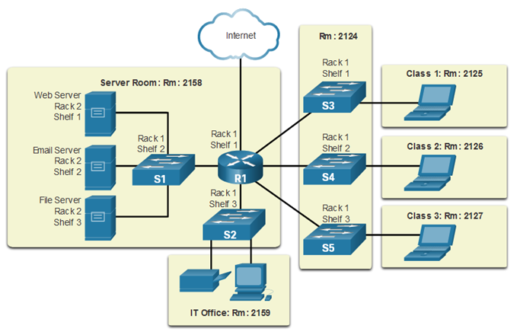
Physical Topology
Physical topology diagrams illustrate the physical location of the devices and cable installation.

Slide 10
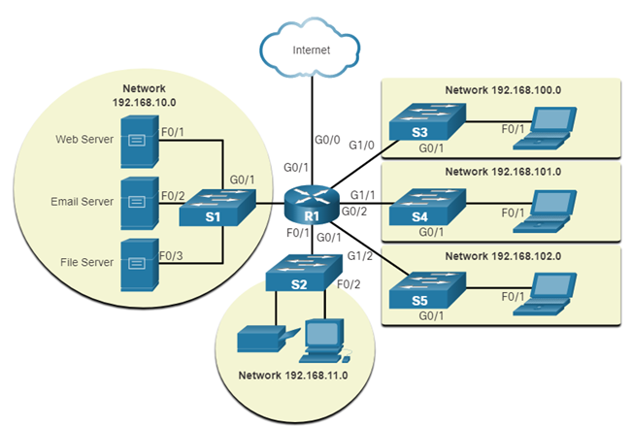
Logical Topology
Logical topology diagrams illustrate devices, ports, and the addressing scheme of the network.

Slide 11
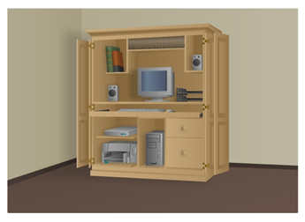
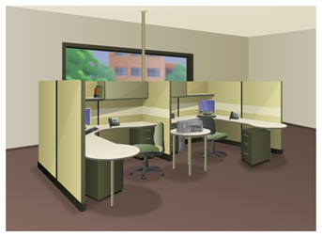
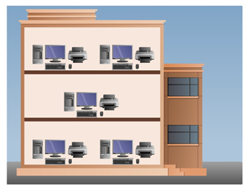
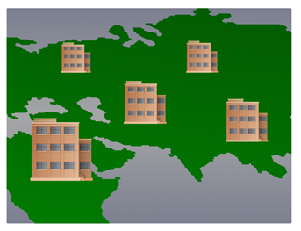
Network of Many sizes
Small Home Networks – connect a few computers to each other and the Internet
Small Office/Home Office – enables computer within a home or remote office to connect to a corporate network
Medium to Large Networks – many locations with hundreds or thousands of interconnected computers
World Wide Networks – connects hundreds of millions of computers world-wide – such as the internet
Small Home SOHO
Medium/Large World Wide

Slide 12
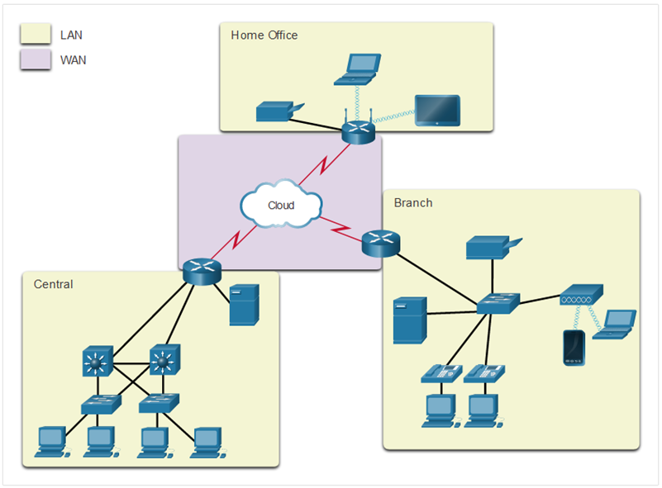
Common Types of Networks LANs and WANs
Network infrastructures vary greatly in terms of:
Size of the area covered
Number of users connected
Number and types of services available
Two most common types of networks:
Local Area Network (LAN)
Wide Area Network (WAN).

Slide 13
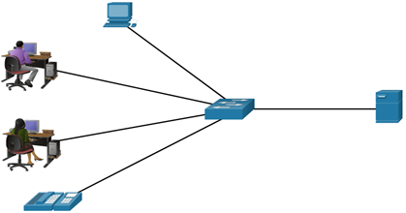
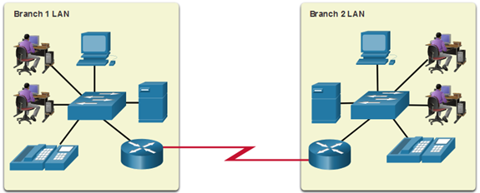
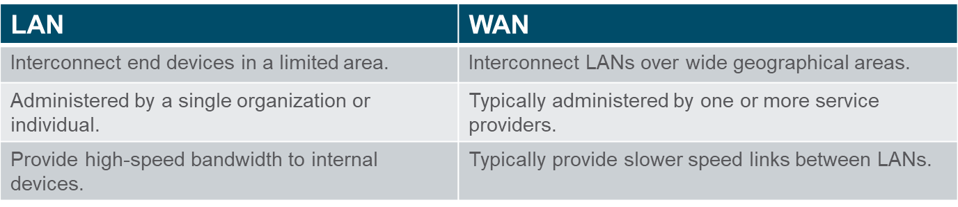
Common Types of Networks LANs and WANs (cont.)
A LAN is a network infrastructure that spans a small geographical area.
A WAN is a network infrastructure that spans a wide geographical area.

Slide 14
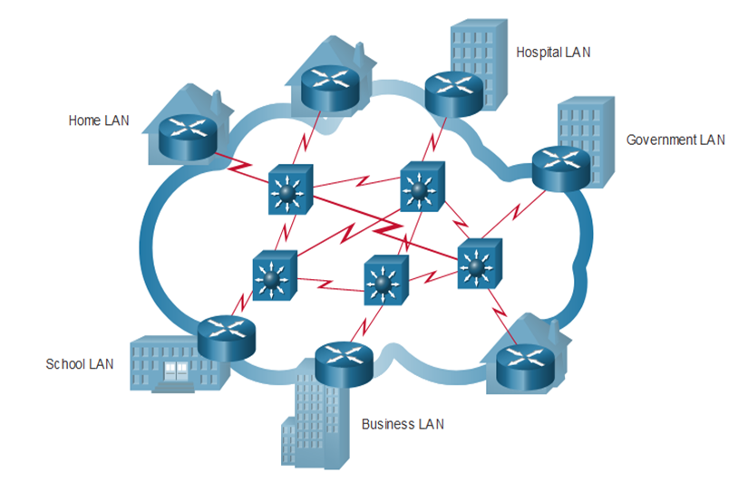
Common Types of Networks The Internet
The internet is a worldwide collection of interconnected LANs and WANs.
LANs are connected to each other using WANs.
WANs may use copper wires, fiber optic cables, and wireless transmissions.

Slide 15
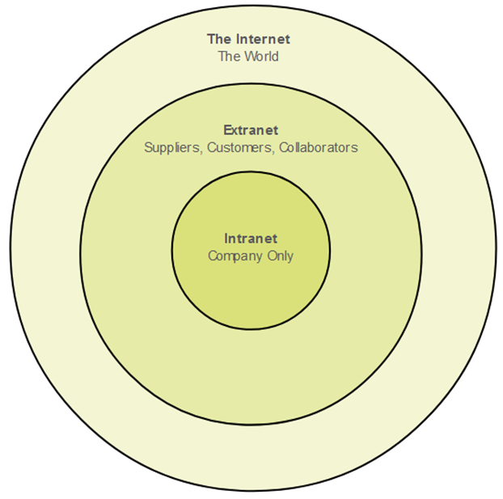
Common Types of Networks Intranets and Extranets
An intranet is a private collection of LANs and WANs internal to an organization that is meant to be accessible only to the organizations members or others with authorization.
An organization might use an extranet to provide secure access to their network for individuals who work for a different organization that need access to their data on their network. For example customers, collaborators,
suppliers

Slide 16
Reliable Network
There are four characteristics that a network needs to address to meet user expectations
Fault Tolerance
Scalability
Quality of Service (QoS)
Security

Slide 17
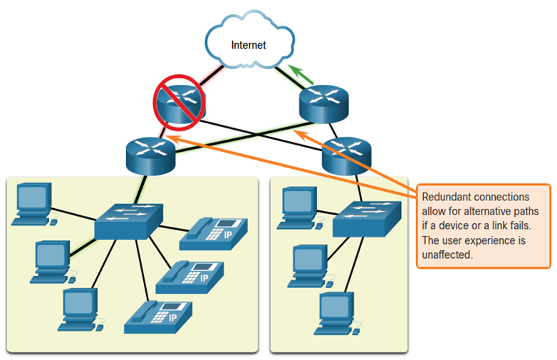
Reliable Network Fault Tolerance
A fault tolerant network limits the impact of a failure by limiting the number of affected devices. Multiple paths are required for fault tolerance.
Reliable networks provide redundancy by implementing a packet switched network:
Packet switching splits traffic into packets that are routed over a network.
Each packet could theoretically take a different path to the destination.

Slide 18
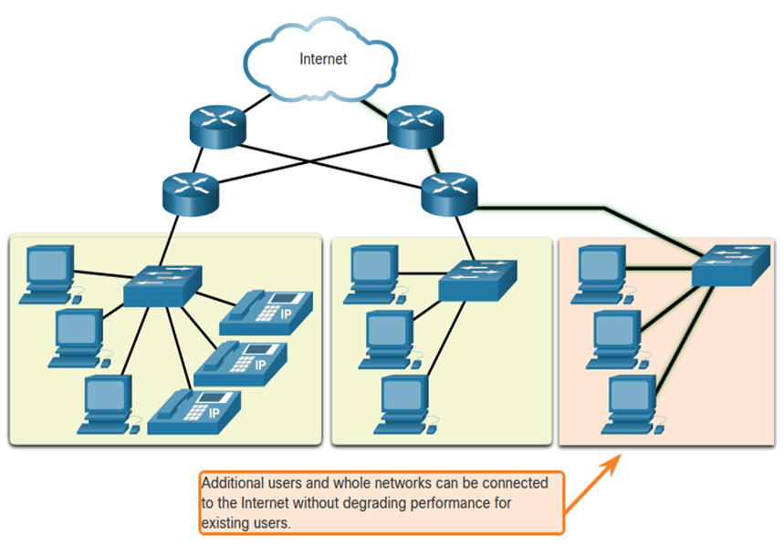
Reliable Network Scalability
A scalable network can expand quickly and easily to support new users and applications without impacting the performance of services to existing users.
Network designers follow accepted standards and protocols in order to make the networks scalable.

Slide 19
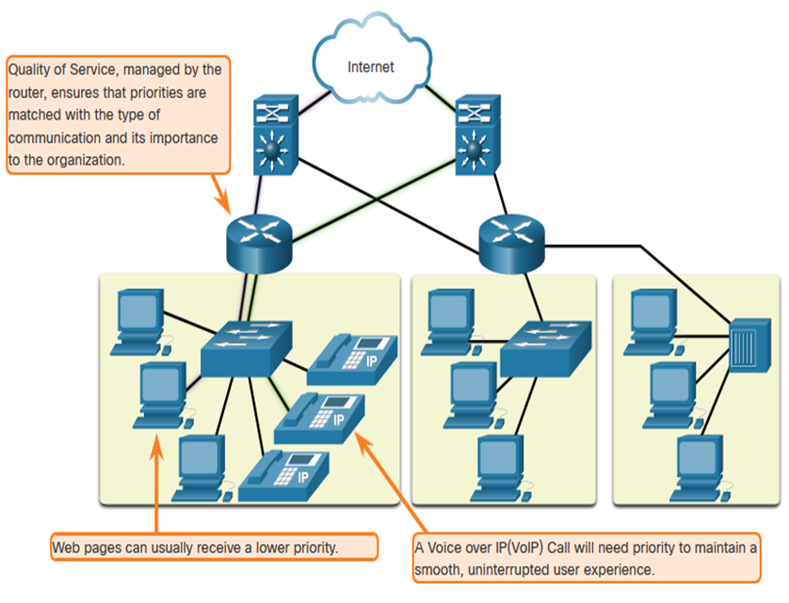
Reliable Network Quality of Service
Voice and live video transmissions require higher expectations for those services being delivered.
configured.
Quality of Service (QoS) is the primary mechanism used to ensure reliable delivery of content for all users.
With a QoS policy in place, the router can more easily manage the flow of data and voice traffic.

Slide 20
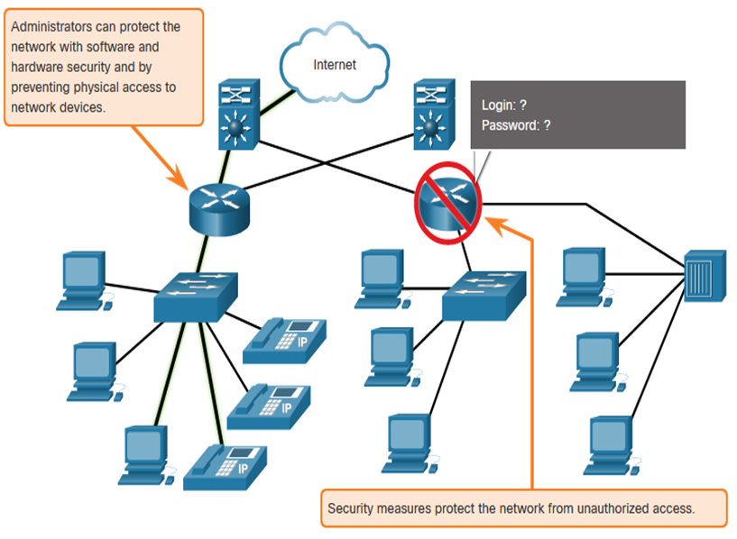
Reliable Network Network Security
There are two main types of network security that must be addressed:
Network infrastructure security
Physical security of network devices
Preventing unauthorized access to the devices
Information Security
Protection of the information or data transmitted over the network
Three goals of network security:
Confidentiality – only intended recipients can read the data
Integrity – assurance that the data has not be altered with during transmission
Availability – assurance of timely and reliable access to data for authorized users

Slide 21
Threats to Network Security
External Threats:
Viruses, worms, and Trojan horses-These contain malicious software or code running on a user device.
Spyware and adware-These are types of software which are installed on a user’s device. The software then secretly collects information about the user.
Zero-day attacks-Also called zero-hour attacks, these occur on the first day that a vulnerability becomes known.
Threat Actor attacks-A malicious person attacks user devices or network resources.
Denial of service attacks-These attacks slow or crash applications and processes on a network device.
Data interception and theft-This attack captures private information from an organization’s network.
Identity theft-This attack steals the login credentials of a user in order to access private data.
Internal Threats:
lost or stolen devices
accidental misuse by employees
malicious employees

Slide 22
Network Security Security Solutions
Small networks
Antivirus and antispyware software should be installed on end devices.
Firewall filtering used to block unauthorized access to the network.
Large networks
Dedicated firewall system-these provide more advanced firewall capabilities that can filter large amounts of traffic with more granularity.
Access control lists (ACL) -These further filter access and traffic forwarding based on IP addresses and applications.
Intrusion prevention systems (IPS)-These identify fast-spreading threats, such as zero-day or zero-hour attacks.
Virtual private networks (VPN)-These provide secure access into an organization for remote workers.

